Slide 1
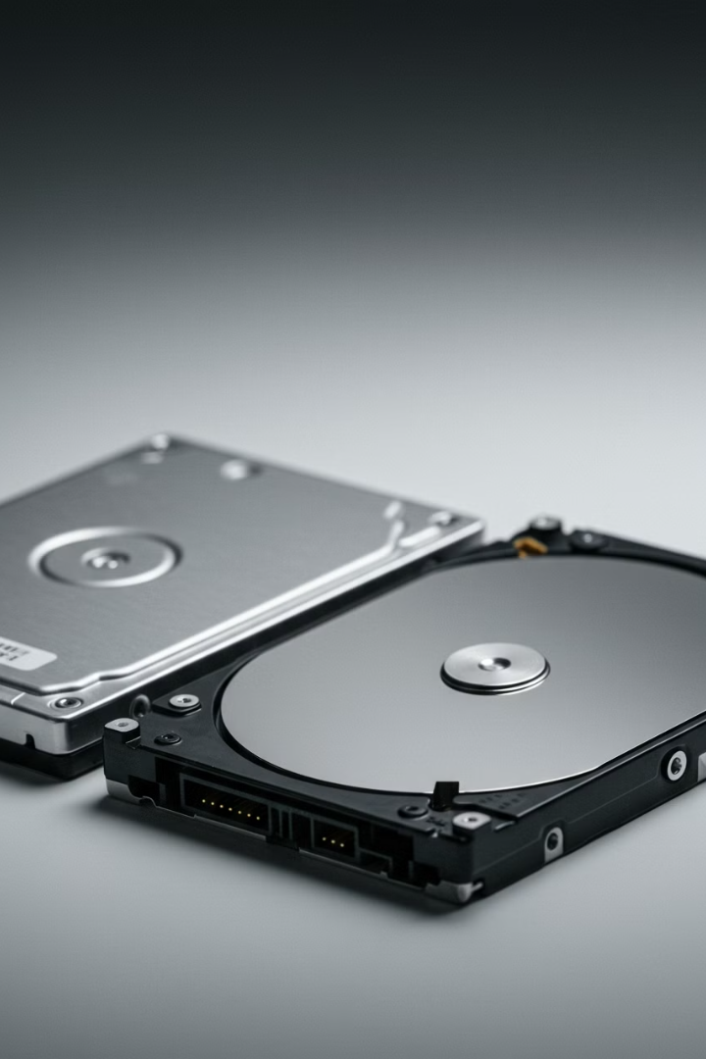

What is Storage
(Hard Drive or SSD)?
Storage is where your computer keeps all its data permanently. This includes your operating system, apps, files, photos, videos, and games. There are two main types of storage: Hard Disk Drive (HDD) and Solid State Drive (SSD). Both store data, but they work differently and have their own advantages and disadvantages.
by Ram N Java

Slide 2
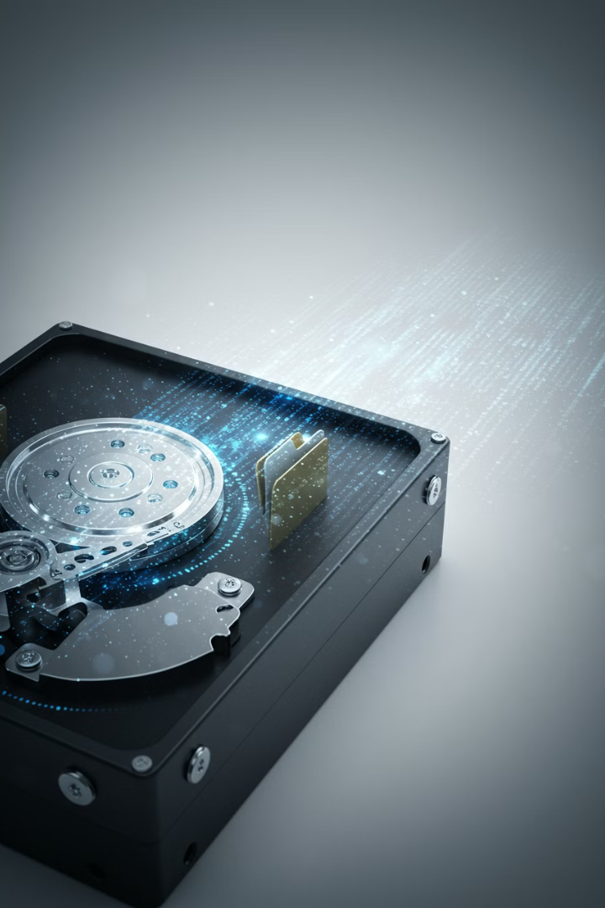
What Does Storage Do?
1
Stores Data Permanently
2
Holds Operating System
Unlike RAM, storage keeps data even when the computer is turned off.
The operating system (like Windows or macOS) is stored here, so your computer can start up.
3
Saves Files
All your documents, photos, videos, and apps
are stored here.

Slide 3
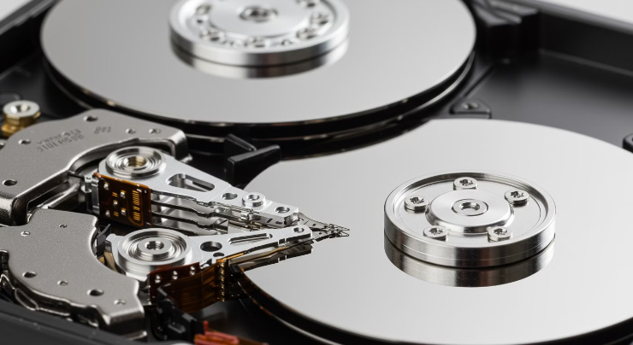
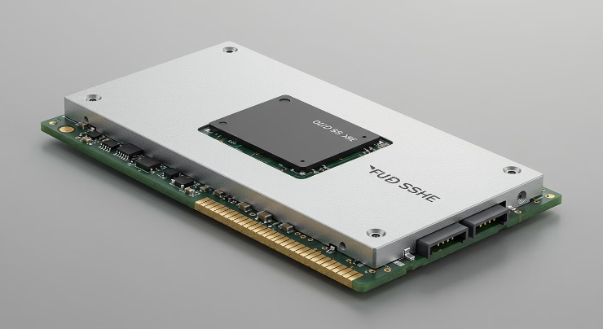
Types of Storage
Hard Disk Drive (HDD)
Solid State Drive (SSD)
Uses spinning disks to read and write data.
Uses flash memory (like a USB drive) to store data.
Slower than SSDs but cheaper for large amounts of storage.
Faster than HDDs but more expensive for the same amount of storage.
Example: A 1TB HDD is good for storing lots of files at a low cost.
Example: A 500GB SSD is great for faster performance and quick access to files.

Slide 4
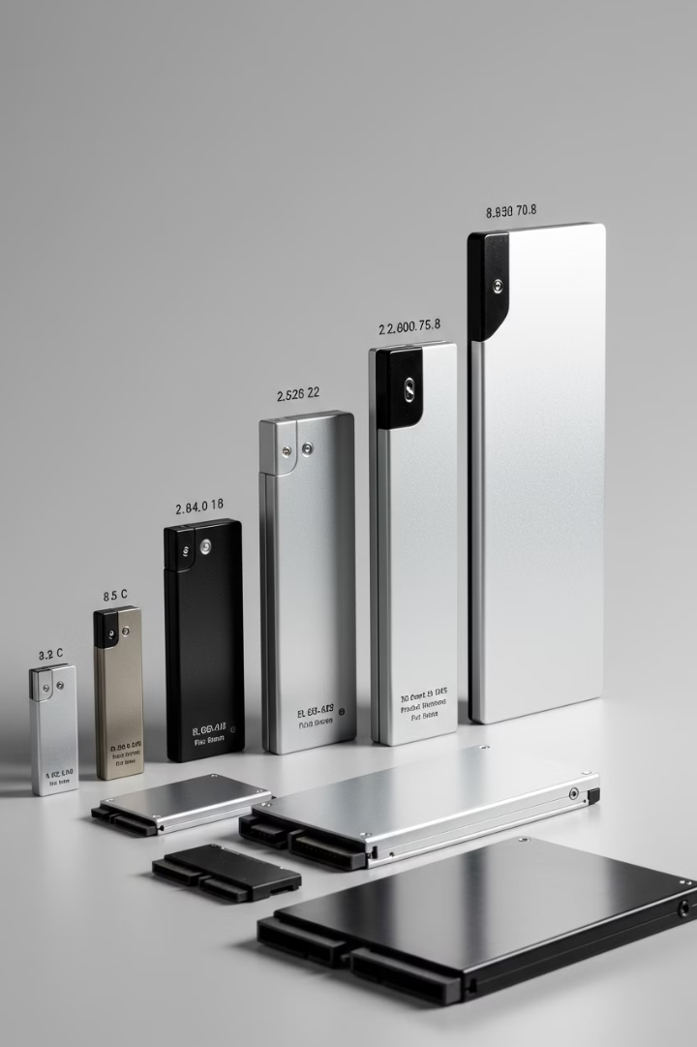
Key Features of Storage
Capacity
Storage is measured in gigabytes (GB) or terabytes (TB).
1TB = 1000GB.
Common sizes: 256GB, 500GB, 1TB, 2TB.
Speed
HDD: Slower, takes more time to load files and programs.
SSD: Much faster, loads files and programs almost instantly.
Durability
HDD: Has moving parts, so it's more prone to damage if dropped.
SSD: No moving parts, so it's more durable and reliable.
Price
HDD: Cheaper for larger storage capacities.
SSD: More expensive but offers better performance.

Slide 5




Why is Storage Important?
Keeps Your Data Safe
Runs Your Operating System
Affects Performance
Stores all your important files, photos, and apps permanently.
Faster storage (like SSDs) makes your computer boot up faster and load programs quickly.
The OS is stored here, so your computer can start up and run.

Slide 6
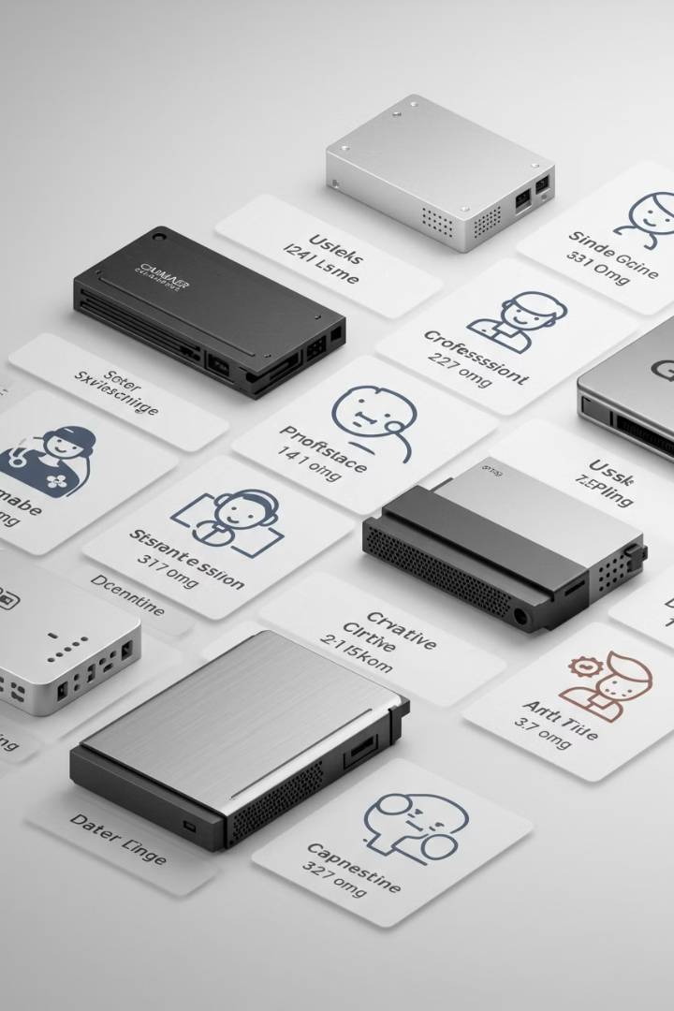
How Much Storage Do You Need?
256GB
500GB
Basic Use
Average Users
Good for basic use like web browsing, emails, and light apps.
Suitable for average users who store photos, videos, and some games.
1TB+
Power Users
Ideal for gamers, content creators, or anyone with large files like videos or high-resolution photos.

Slide 7
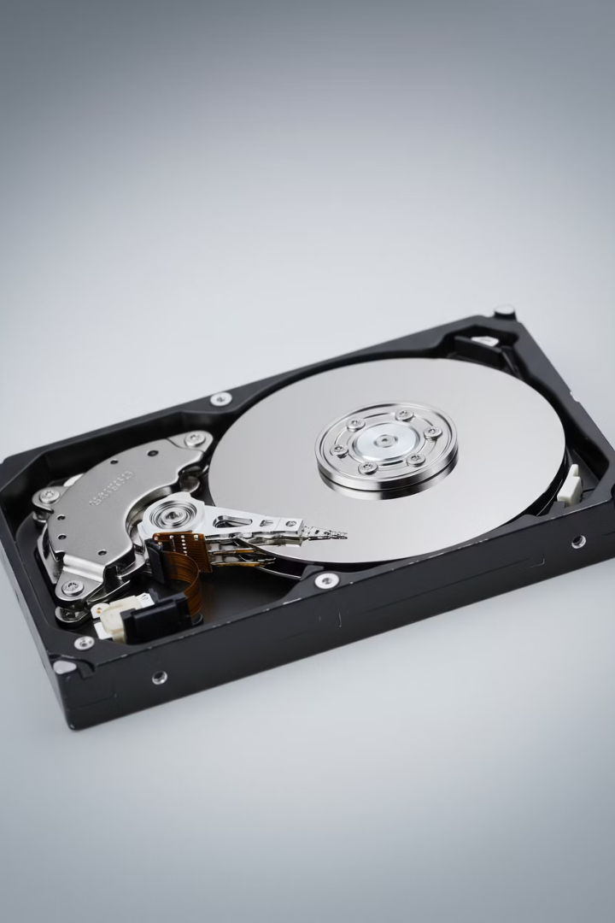
Advantages and Disadvantages of HDD
1
Cheaper
Costs less for larger storage capacities.
2
Good for Bulk Storage
Great for storing large files like movies or backups.
3
Slower
Takes more time to load files and programs.
4
Fragile
Has moving parts, so it's more likely to get damaged
if dropped.

Slide 8
Advantages and Disadvantages of SSD
Faster
Boots up the computer and loads programs quickly.
Durable
No moving parts, so it's more resistant to damage.
Energy Efficient
Uses less power, which is good for laptops.
Expensive
Costs more for the same amount of storage compared to HDDs.
Limited Lifespan
SSDs have a limited number of write cycles, but they last many years under normal use.

Slide 9




Simple Summary
Storage Fundamentals
HDD Benefits & Drawbacks
Storage is where your computer keeps all its data permanently.
1
2
HDD is cheaper and good for large files, but it's slower.
Choosing Storage
SSD Benefits & Drawbacks
4
3
Choose HDD for budget storage and SSD for better performance.
SSD is faster and more durable, but it's more expensive.

